Slide 1
June 23, 2015
MI-SPI Collection Analysis
Rick Lugg & Andy Breeding
Sustainable Collection Services/OCLC

Slide 2


SCS Mission
Mission
Helping Libraries Manage and Share Print Monographs
To help libraries manage and share print monographs
Notes:
We also run seminars aimed at educating stakeholders on these issues

Slide 3
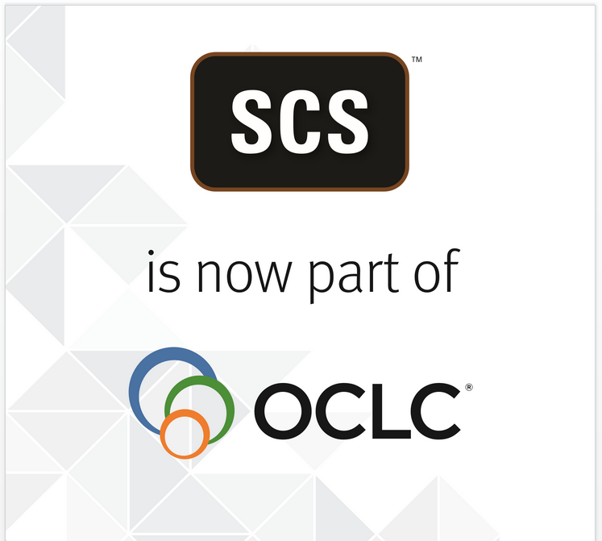
January 8, 2015

Slide 4
SCS: Vendor Support for
Monographs Analysis
Consulting
Project Management
Tools to interact & visualize
Value added to data
Data

Slide 5
SCS Team & experience

Slide 6
SCS People & Roles in MI-SPI Project
Andy Breeding Project Manager/Analyst
Rick Lugg General oversight/strategy
Ruth Fischer Project Analyst as needed
Eric Redman Individual and group data preparation
Argentic Software Developers of GreenGlass

Slide 7
MI-SPI Steering Committee
Pamela Grudzien (Central)
Mike Hawthorne (Wayne)
Julie Garrison (Grand Valley State)
Thom Zantow (Saginaw Valley State)
Helen Levenson (Oakland)
Randy Dykhuis (MCLS)

Slide 8
SCS Shared Print Monographs Projects
MI-SPI (x2)
CNY
Maine
VIVA Video
VIVA Books
WRLC
CI-CCI
TUG
ALI/PALNI
CSUs
As of February 2015, retention commitments for 8 million title-holdings.
These represent
3.8 million distinct OCLC numbers.
Notes:
Our first group project occurred in 2012 – with the Michigan Shared Print Initiative (MI-SPI). MI-SPI has just committed to a second group project – not quite three years after the first.
Overall, we’ve worked with 9 groups and have learned a lot on each project.
Some have been very small groups, TUG – the Tri-University Group in Canada (Guelph, Waterloo, and Wilfred Laurier)
CI-CCI – is a group of 5 small liberal arts colleges in central Iowa.
Some groups have a shared infrastructure and system --- in other groups this is not the case.
ALI – Academic Libraries of Indiana was our biggest project to date with 36 libraries ranging in size from ½ million titles to fewer than 50,000.
We are looking forward to working with EAST – which (along with the MI-SPI group, will be our first group projects that will be able to take advantage of G3.
With regard to the retention commitments made so far, they have (for the most part) been informal commitments, made to other members of the group. To our knowledge, only Maine has formally recorded their commitments in WorldCat.
Several reasons for this …..

Slide 9
Strong Preferences: Print, Self-Sufficiency, Proximity
Hathi Trust or other digital surrogate
Print in Collective Collection
Print in state
Print within group

Slide 10

Define the group or entity
Analyze collection data
Decision support
Allocate retention commitments

Slide 11
Define the group or entity
Review reconsider renew
Analyze collection data
Access
Decision support
Discovery
Allocate retention commitments
Weed
Register retention commitments

Slide 12
Mi-spi project plan

Slide 13
Project Goals
Quantify usage and overlap among the group
Share responsibility for retention
Identify and protect scarcely-held titles
Withdraw surplus copies of widely-held, low-use materials
Work toward incorporating collection analysis into ongoing operations
    Analysis on demand
    Scheduled data refreshes
    Predictable budgeting

Slide 14
Category 1: New Data Sets
Institution | # of monographs | ILS
Central Michigan | 558,759 | Innovative
Ferris State | 153,422 | Innovative
Grand Valley | 292,904 | Innovative
Michigan-Dearborn | 238,792 | Innovative Sierra
Michigan Tech | 174,538 | Voyager
Northern Michigan | 280,994 | Voyager
Oakland | 325,296 | Voyager
Saginaw Valley | 169,899 | Innovative
Wayne State | 700,473 | Innovative
TOTAL | 2,895,077

Slide 15
Category 2: Retention Lists as Targets
Eastern Michigan
Western Michigan
Retention commitments as targets: SCS will reformat retention lists from 2013 for these two libraries, and incorporate those commitments into the MI-SPI group data set. Exact method still to be determined.

Slide 16
Project Scope
In Scope: Circulating Print Monographs
Out of Scope:
    Journals/Serials [record type ‘s’]
    Special Collections
    Reference
    E-Books
    Government Documents
    Media
    Microforms
    Scores
    Juvenile
    Maps
    Lost/Withdrawn

Slide 17
Project Timeline
Task | Timeframe
Kick-off Meeting | June
Confirm Project Leadership/Communication | June
Confirm Scope and Specifications | June-July
Category 1 Libraries: Data Questionnaire | June-July
Category 1 Libraries: Supply Bib, Item, Circ Data | July-August
Category 2 Libraries: Configure Retention Lists for Matching | July-August
SCS will assess & optimize group-wide data strategy | August
WorldCat validation & matching; Hathi Trust matching | September
Category 1Libraries: match against Category 2 retention lists | September

Slide 18
Project Timeline
Task | Timeframe
Category 1: Compile and validate individual data roll-ups | October
GreenGlass access for Individual Libraries [optional] | October
Compile the MI-SPI group-wide database | October
GreenGlass for Groups (G3) access | November
Experiment with Retention Scenarios using G3 | November-December
Discussion/Decisions on MI-SPI retention commitments | November-December
Allocation of retention commitments by SCS | December
Re-load of GreenGlass to reflect retention commitments and establish a safety net | January 2016
Individual libraries declare retention commitments in catalogs, WorldCat (?)
Individual libraries deselect as needed for titles they are not assigned to retain
Ongoing data management | Through June 2017

Slide 19
Scs methods & greenglass

Slide 20
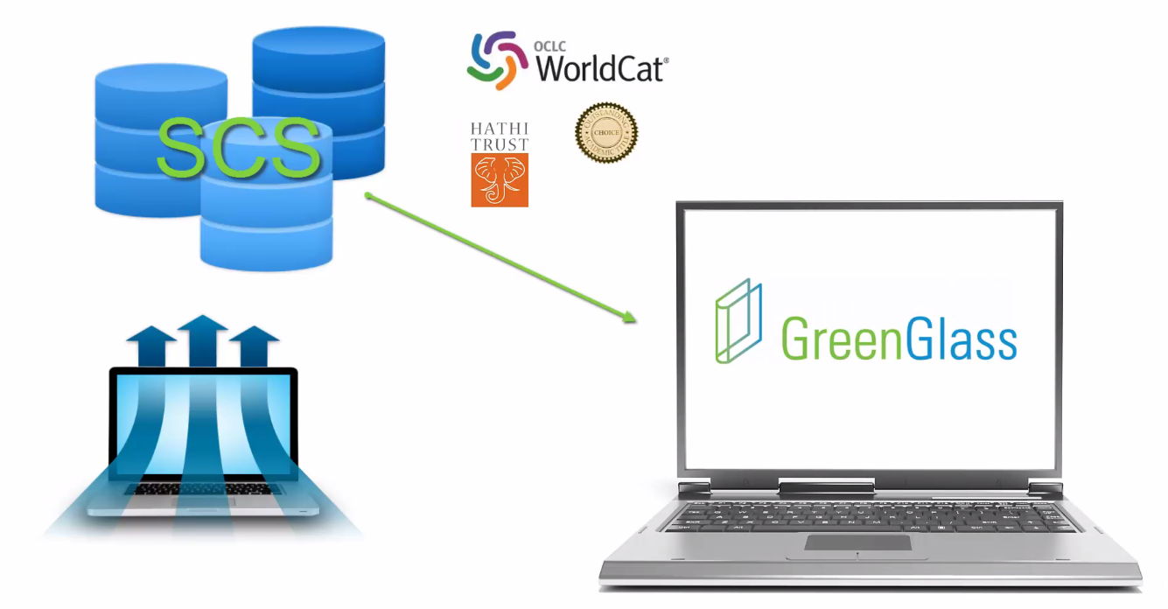
Library’s bib, item and transaction data for PRINT MONOGRAPHS
Notes:
Sustainable Collection Services starts with the library’s own data, extracted from the ILS. They cleanse, filter and normalize it – and then match it against HathiTrust, CHOICE, and WorldCat. This enhanced data is then loaded to GreenGlass.

Slide 21
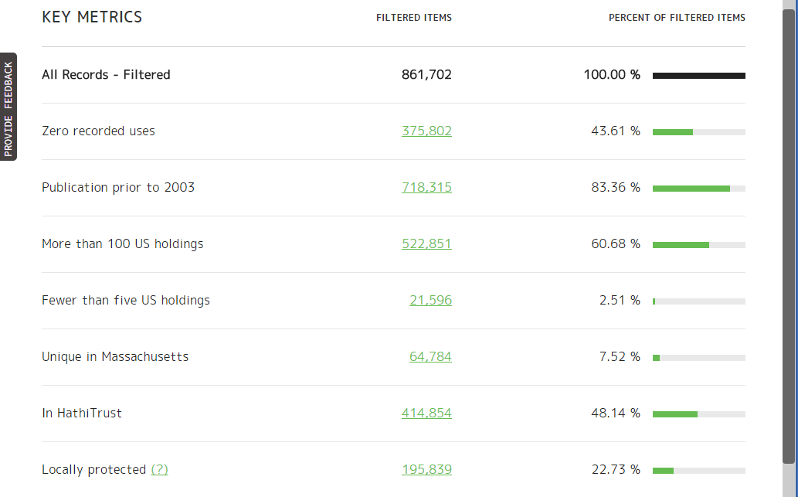
Notes:
GreenGlass – first released in 2012 - is designed to facilitate the analysis of a single library collection in the CONTEXT of the collective collection. Most libraries choose to work with SCS and GreenGlass because they want to responsibly, rationally, and efficiently downsize their print monographs collection. But the first step is typically to identify resources that are SCARCELY held in the country, in the region, or among a specific group of partner libraries.

Slide 22
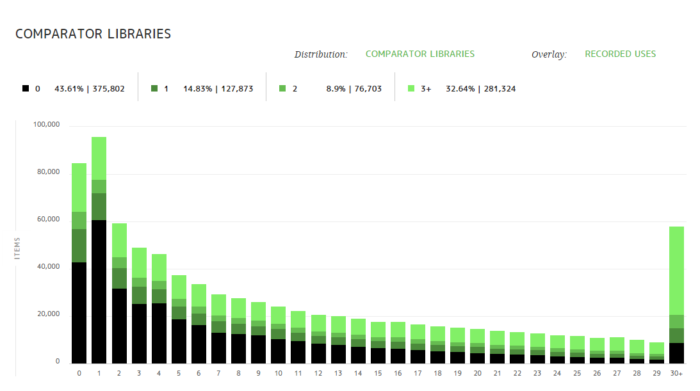
COMPARATOR LIBARIES
Notes:
The GreenGlass Collection Visualization feature offers the user new insights into the character of her collection; helps her to see the collection in many ways – most of which will be brand new. For example, this is the shape of one library’s collection in the context of their named borrowing partners. The ‘0’ bar on the far left represents all the items owned by ‘my library’ that are not owned by ANY of my primary ILL partners. The bar on the far right represents items owned by my library that are also held by 30 or more of my primary ILL partners. The green portions of each bar represent local usage and the black base of each bar represents items with 0 recorded uses. This GreenGlass Visualization Tool supports up to a dozen different distributions and four overlays – so more than 40 discrete views. SCS encourages users to familiarize themselves with all these facets – get to know their collection in new ways - so that their interaction with the GreenGlass Query Builder is efficient and intuitive.

Slide 23
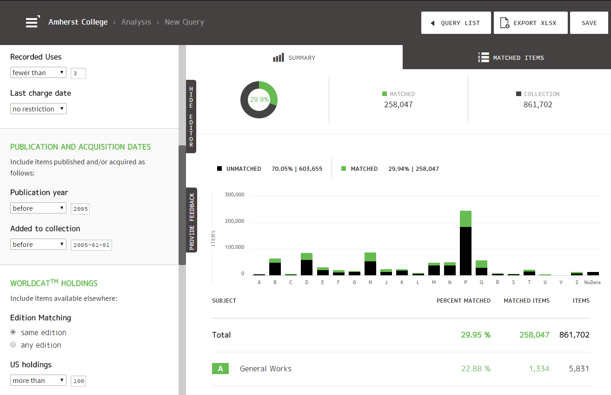
Sample
Notes:
The GreenGlass Query Builder allows libraries to slice and dice their collection in an infinite number of ways. Each time the user enters or changes a new parameter or threshold, the impact can be seen immediately. The idea here, is that users can efficiently experiment with a wide variety of preservation and/or weeding scenarios. The list of items that match the current scenario can be viewed online – or downloaded for further manipulation.
So that’s an overview of the current GreenGlass feature set. Now we’ll move onto Shared Print, in the SCS environment.

Slide 24
GreenGlass for Groups (G3)
G3 employs data visualizations and modeling tools to enable groups of libraries to:
    understand their shared collection in terms of overlap, subject dispersion, and usage.
    experiment with various retention scenarios, and estimate the impact on each participant library.
    commit to specific retention agreements, with confidence in the outcome.

Slide 25
GreenGlass for Groups (G3)
G3 employs query tools and items list to enable individual libraries to:
  protect the right books and thereby share responsibility for the collective collection.
  downsize print monographs collections, knowing that long-term access to the content has been assured.

Slide 26
GreenGlass for Groups (G3)
In development – September 2015 launch
Works in tandem with proven GreenGlass features
G3 Features
    Data Visualization: group data set
    Model Builder: estimate the impact of various retention scenarios
    Post-allocation Workflow Support
        Reload GreenGlass
        Enhanced Query Builder
        Enhanced Item Lists

Slide 27
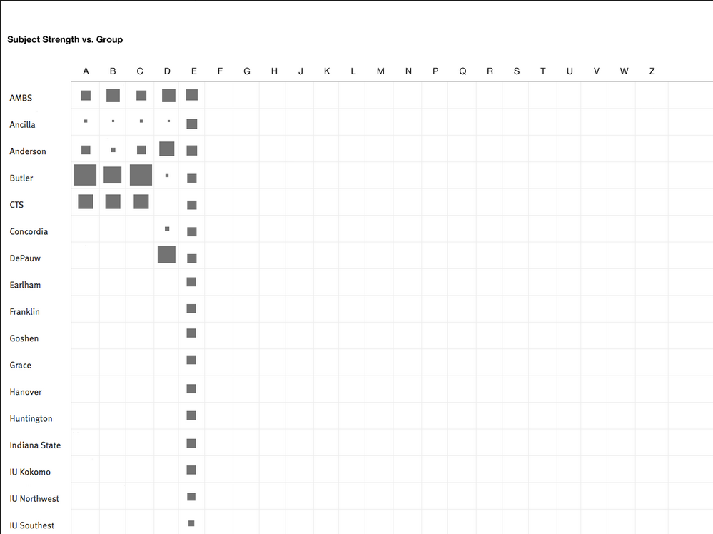
G3 Visualization Tools will be focused on the Shared Collection and will be metric specific
Size
Overlap
  Among project participants
  Comparator libraries
  State or province
  Country
  World
  HathiTrust
  CHOICE
Subject
Usage
Pub Year/Age of Collection
Still in development – Actual product screens TBD
Notes:
Our intent is that the visualization Tools in G3 will transform huge amounts of disparate collections data into engaging, intuitive displays – designed to help users understand the nature of the shared collection --- AND their own library’s respective position within the group.
SCS has just begun the work of designing G3 visualization tools. The background of this slide represents a recent experiment that offers a view of LC class comparisons across the group. With regard to subject, we care about relative size AND relative UNIQUENESS within the group.
Just like the intent of the visualization tool in GreenGlass, the visualization tools in G3 are intended to help users learn enough about the shape and patterns of the shared collection, that their subsequent experimentation with the Model builder will be efficient and intuitive.

Slide 28
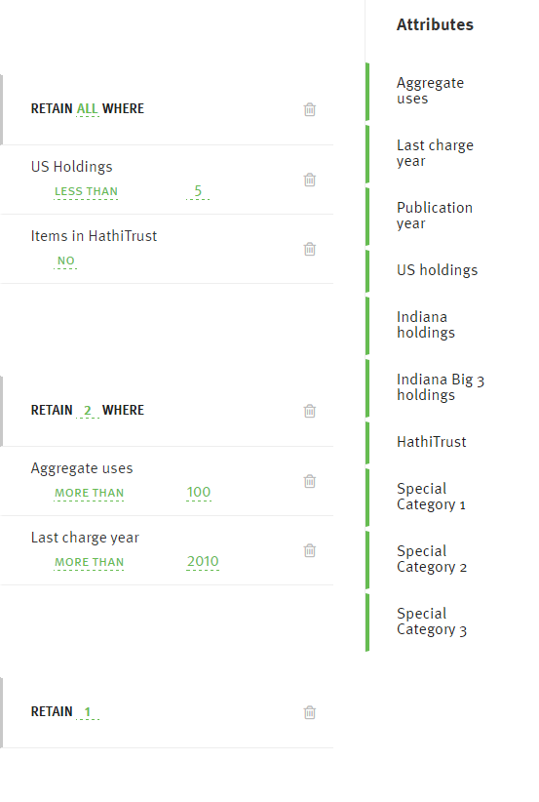
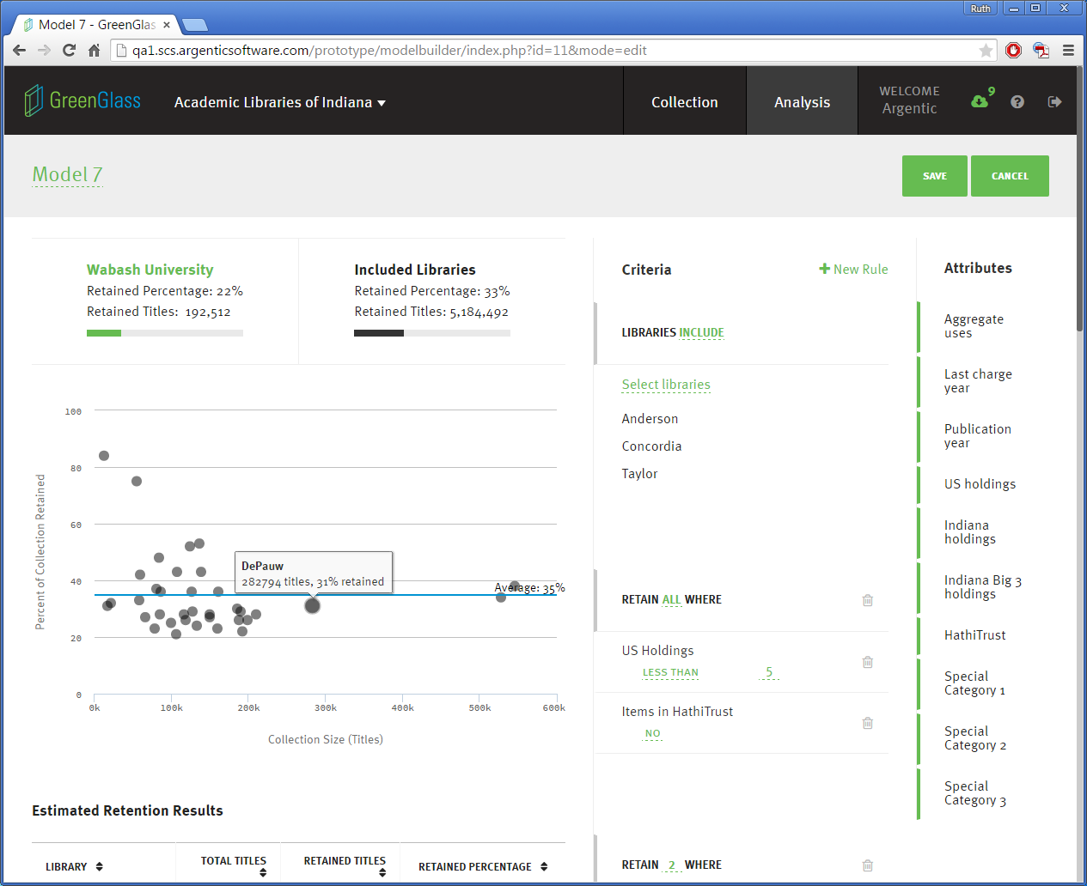
My
LATER THAN
Still in development – Actual product screens TBD
Notes:
The GreenGlass Model Builder is also under development. But we’ve made some great strides with its design during the last few months. We had a great opportunity to talk about it at ACRL – with existing group members and with prospective users. And we’ve already incorporated a couple of elements of Key Feedback from that conference.
Group Models are always retention focused. For many (perhaps MOST) group members, a retention agreement = a safety net, which allows them to subsequently downsize their local collection of print monographs – responsibly and efficiently.
Things to point out:
Retention commitments plotted by library. The horizontal axis represents size of collection and the vertical axis represents the percentage of the collection that will be retained, given the parameters of a given retention model.
The blue average retention bar – supports conversations of retention equity
Users can experiment with which libraries are included in specific retention models.
Users will build retention models by choosing specific collection attributes from the right margin and setting specific thresholds and retention levels.
Unlimited number of rules.
Special Categories will be defined by the group. One use case will be to flag items that are already in high-density storage. Another use case is to flag items that are non-circulating. Another use-case, is to flag print books for which an electronic edition is also owned.

Slide 29
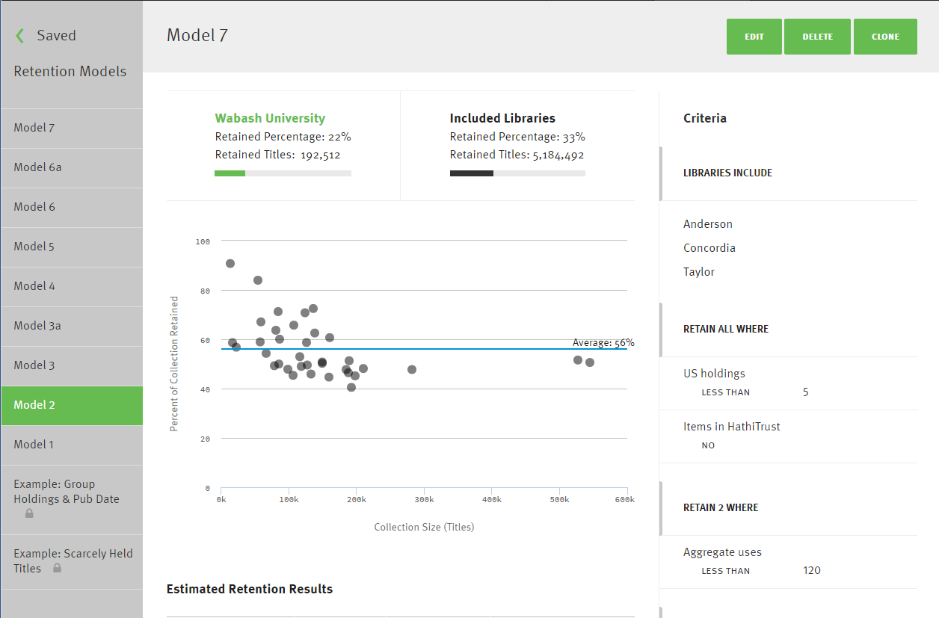
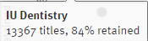

Model 2
My
68%
Still in development – Actual product screens TBD
Notes:
When a number of different retention models have been built and saved (in the left margin) --- the user can bounce back and forth between them, to compare, contrast, discuss, and finally decide. Conversations about equity are supported via the Average Retention Bar.
Since most groups have no experience with this kind of work, they are often interested to know “What have other groups done?” SCS will pre-populate the G3 Model Builder with the final retention models implemented by other SCS groups – so each new project can take advantage of the learnings of others.

Slide 30
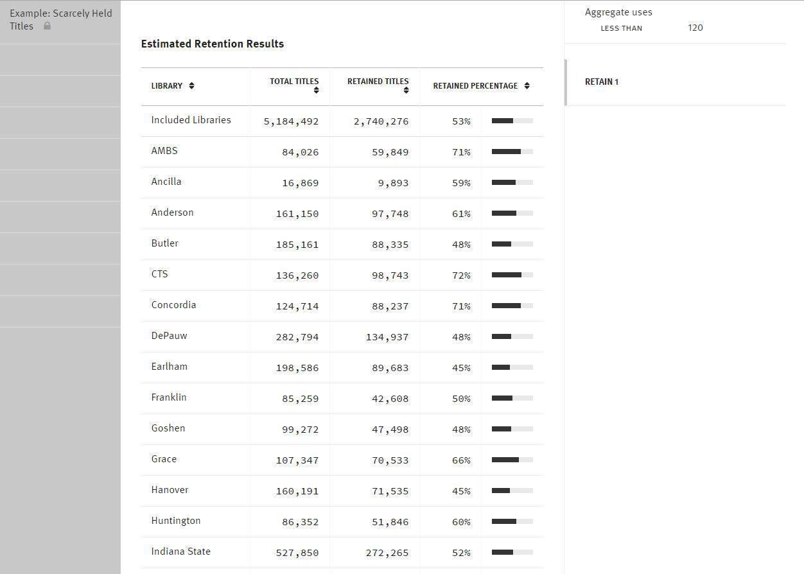
Still in development – Actual product screens TBD
Notes:
Retention estimates for each model are also available in tabular form.
These kinds of data are the ONLY output from the G3 Model Builder. Again – this tool is designed to
Help define the group
Introduce new concepts and vocabulary
Facilitate the conversation
Ensure a shared understanding of the retention agreement
After a group has finalized their retention model, SCS will allocate retention commitments to each library, and GreenGlass will be reloaded – with additional group-level data elements which will be visible at the item level and which can be used in queries. This additional data allows libraries to create local weeding scenarios based not only on their own library data, but on group-wide thresholds as well.

Slide 31
Retention Allocations and Beyond
SCS allocates retention commitments to participant libraries
SCS reloads GreenGlass to reflect retention allocations
Participant libraries validate and secure their retained items
Participant libraries weed according to local needs

Slide 32
Define the group or entity
Analyze collection data
Decision support
Allocate retention commitments

Slide 33
Next steps

Slide 34
Cataloging & Data Questionnaire
Voyager Libraries: Oakland, Tech, Northern
Innovative Libraries: everyone else
To help us understand your data
Item status codes, item type codes, location codes, etc.
Andy will send these out soon. Who should get it at your library? Should we send via the listserv?

Slide 35
What you’ll need to complete the questionnaire
    Local cataloging practices
      E.g., where is the system control number; which call number should we use;
    Data extract processes (contact name)
      E.g., who will actually provide the extract(s) to SCS?
    Access services
      E.g., who knows about circulation transactions, in-house uses
    Collection management/development
      E.g., what questions or comparisons are wanted from the data?

Slide 36
Comparator Groups
Does MI-SPI want to compare its holdings with any specific group(s) of external comparators?
SCS will supply US Holdings, Michigan holdings, Hathi Trust holdings
We can support up to five groups, total of 100 holdings symbols
http://www.oclc.org/support/training/portfolios/library-management/sustainable-collections/tutorials/establish-your-list-comparator-lib.en.html

Slide 37
Confirm Timeline
Complete Cataloging & Data Questionnaire
Confirmed list of Comparator Groups
Workable Data Extracts
Can we get all of these by the end of August?

Slide 38
Project Timeline
Task | Timeframe
Kick-off Meeting | June
Confirm Project Leadership/Communication | June
Confirm Scope and Specifications | June-July
Category 1 Libraries: Data Questionnaire | June-July
Category 1 Libraries: Supply Bib, Item, Circ Data | July-August
Category 2 Libraries: Configure Retention Lists for Matching | July-August
SCS will assess & optimize group-wide data strategy | August
WorldCat validation & matching; Hathi Trust matching | September
Category 1Libraries: match against Category 2 retention lists | September

Slide 39
Questions?
Andy Breeding
breedina@oclc.org
Rick Lugg
luggr@oclc.org

